Slide 1
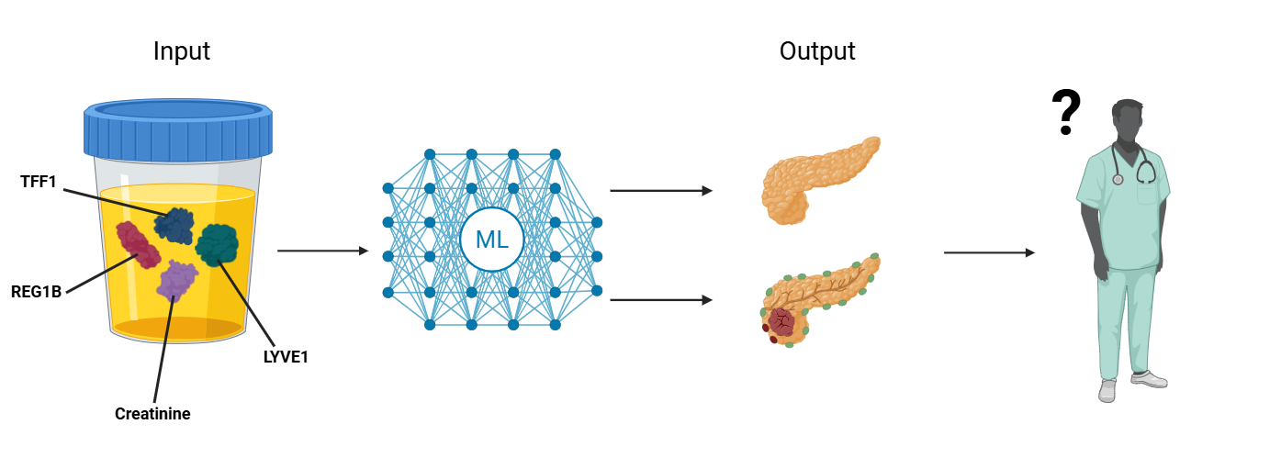
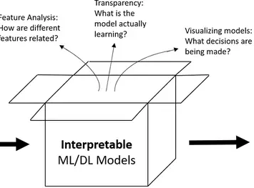
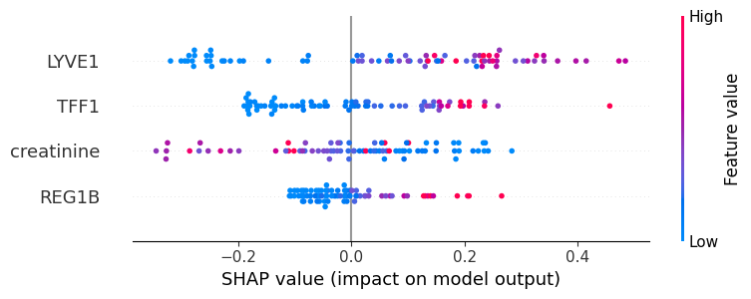
Why Interpretability Matters in Clinical ML Models
Can I trust the model output?
OUTPUT (Healthy or Cancer)
“Black-Box” ML Models
Prediction: Cancer (85%)
⚠ No explanation provided
Now I understand how the model made this prediction
Predictive Biomarkers
OUTPUT (Healthy or Cancer)
Prediction: Cancer (85%)

